Slide 1

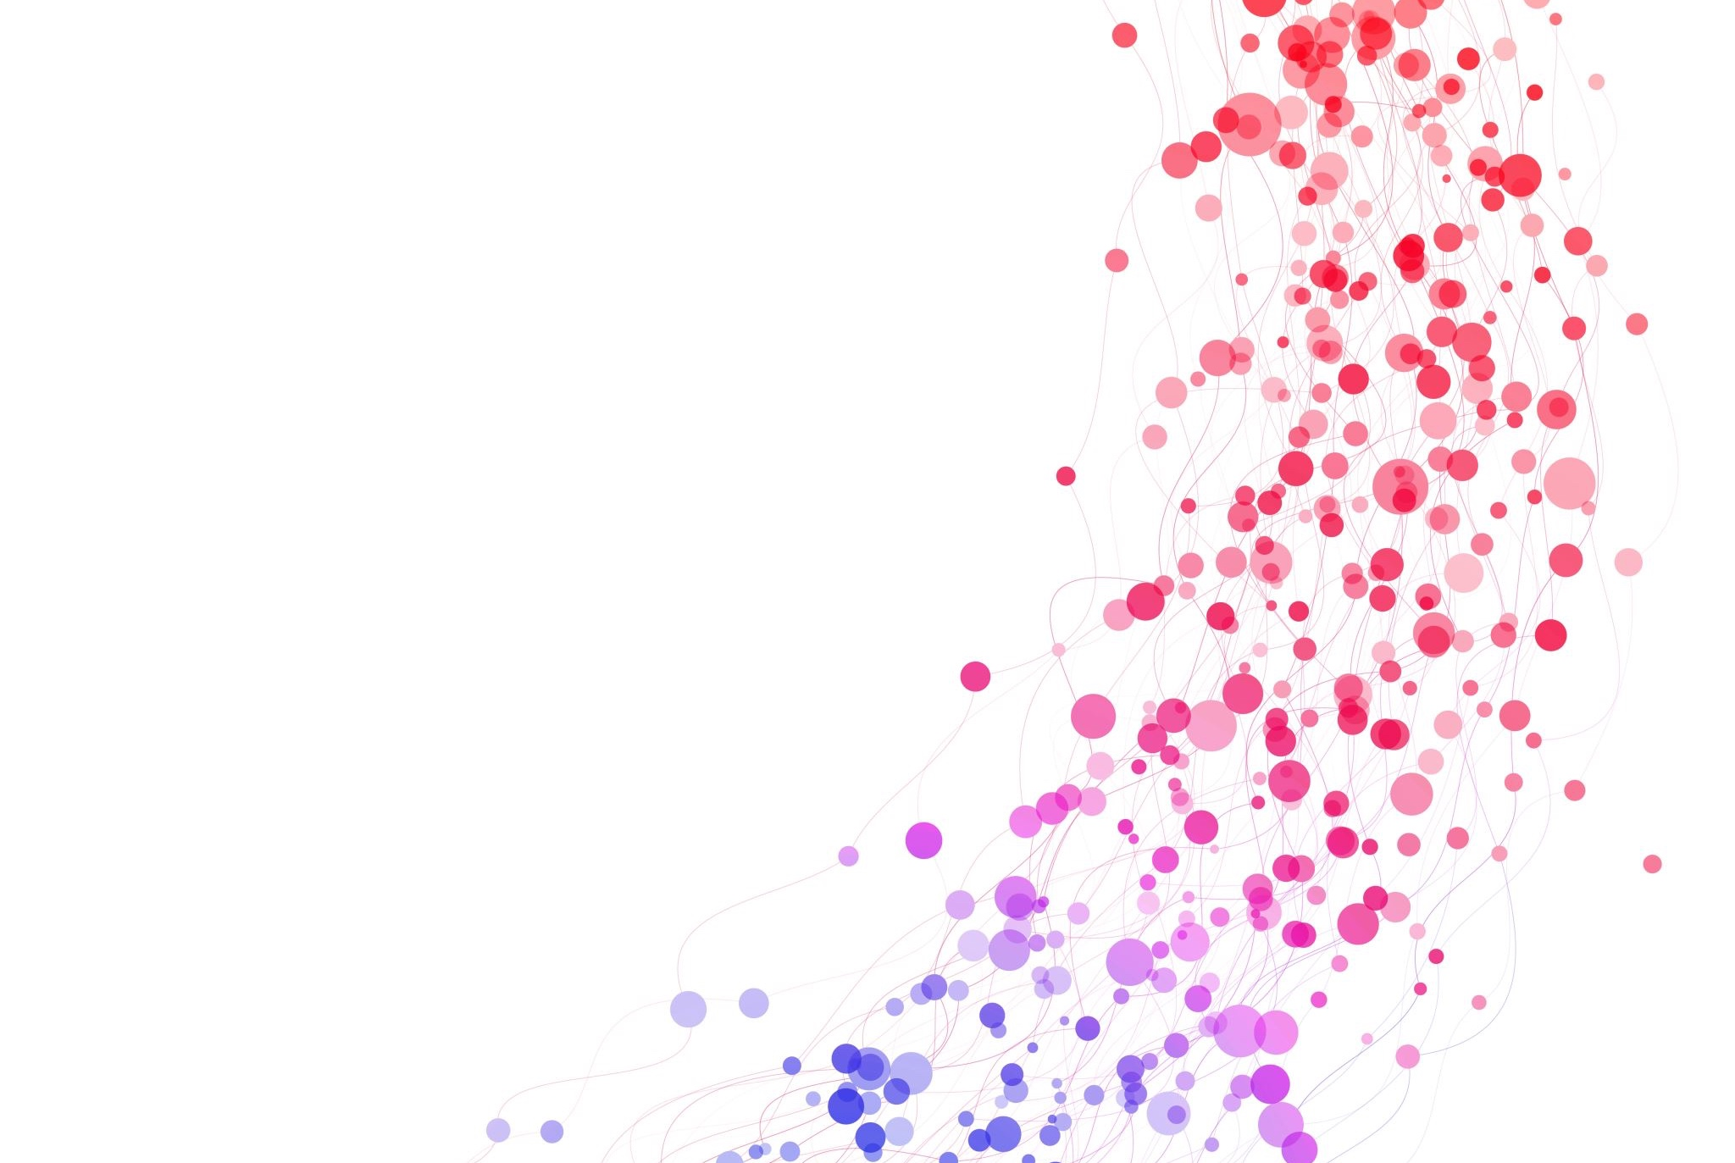
Where will I open my Austin bubble tea shop?
Analysis of Neighborhoods and Related Attractions for a New Business in Austin, Texas

Slide 2
Table of Contents
Introduction: Business Problem
Data
Methodology
Analysis
Results and Discussion
Conclusion

Slide 3
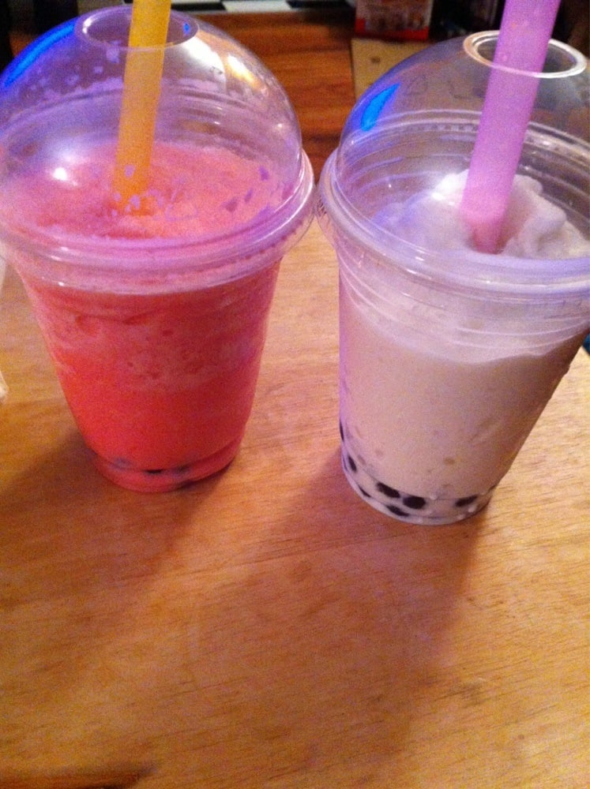
Introduction: Business Problem
Bubble tea, or “boba”, is a popular drink in Asia. The bubbles are balls of tapioca that are flavored with tea, then placed in a cup with tea, juice, ice cream, and other sweet, cold liquid ingredients.
Many cosmopolitan cities have bubble tea shops.
Austin is a cultural, educational & business hub. It has many leisure venues, and a warm climate where a cool snack product like bubble tea would be popular.
This project intends to find patterns in the locations of bubble tea shops, then find similar locations where a new bubble tea shop would have enough customer traffic.
The GitHub link for this project is: https://github.com/LoriQuarnstrom/DataScienceCapstone/blob/master/FINAL%20-%20Where%20to%20open%20an%20Austin%20bubble%20tea%20shop

Slide 4
Data
The data used is:
Location data for Austin
Foursquare venue data
Simple dataframes for organizing location & venue data
The data science applications used are:
Foursquare for finding venues and associated data
Nominatim for latitude / longitude
Folium and Geopy for mapping
Numpy, Pandas and Matplot lib for defining and cleaning data

Slide 5
Methodology
This section contains the setup and Python code I'll use to prepare my results. The sections are as follows:
Prepare Libraries & Tools
Set up Foursquare credentials
Visualize the neighborhoods in Austin, Texas
Collect venue data
I will not use machine learning or clustering in this methodology.

Slide 6
Methodology, continued
Prepare Libraries & Tools
Please refer to the Notebook on GitHub.
Set up Foursquare credentials
Please refer to the Notebook on GitHub.
Visualize the neighborhoods in Austin, Texas
The map at right shows the neighborhoods in Austin. The data for these neighborhoods was built from a neighborhood list located at https://en.wikipedia.org/wiki/List_of_Austin_neighborhoods
The Latitude and Longitude were built manually using Nominatim, then uploaded via comma-delimited .CSV file.

Slide 7
Methodology, continued
Collect venue data
Please refer to the Notebook on GitHub.
All venues for Austin neighborhoods were queried from Foursquare, and the JSON data placed in a dataframe.
The Venue Category field contained only one Bubble Tea Shop. The other bubble tea shops in Austin didn’t appear at all in the list of 822 venues returned for Austin.

Slide 8
Analysis
Does Foursquare have useful Bubble Tea data?
Only one business was categorized as a Bubble Tea Shop. Google Maps shows 20 bubble tea shops in Austin.
A simple text search only searches business names
The search “bubble tea” returned tea shops, but also “Austin Defense Team: Criminal Defense Attorneys”
The search “bubble boba” returned more relevant results, but also “The Bubble Recording Studio”.
Since “bubble boba” was more relevant, I mapped the venues in the map to the right. (Please refer to the Notebook for specific business results.)

Slide 9
Results and Discussion
I found that the results of this experiment were mixed.
I was able to map neighborhoods, but I had to build the neighborhood lat/long table by hand using Nominatim for each of the Austin neighborhoods, then upload it in a .CSV file. The course didn't get into building lat/long values in a dataframe automatically. When I study Data Science in more depth, I will figure out how to do this properly.
Foursquare enabled me to find some of the venue data I was looking for, but it was incomplete when compared to other sources like Google Maps.
The limited tools and my schedule didn’t allow time to analyze other neighborhood attractions.
Even these limited results were extremely time-consuming for me. I reviewed the relevant modules and experimented a lot. This exercise taught me a great deal, but I don't think I'd use these tools in my professional consulting career.

Slide 10
Conclusion
I didn't find a conclusion to my business problem. This is partly because I spent a lot of time trying to apply tools from previous lessons to my problem. Iterating through Foursquare searches for relevant businesses in areas with existing bubble tea shops was not appealing. Still, I can see that, with a bit more practice in executing correct searches and examining data, I might be able to get the relevant attractions, and apply the model to other geographic area.
This Coursera course was a good introduction to Data Science. I was able to work through the steps of these and other experiments, and use the tools to get results.

